Slide 1


NYU Summer Machine Learning Program
Presenter Name Here
Date Here

Slide 2

Mini-Project
Day 5

Slide 3
Learning Objectives
Apply the knowledges we have learned to solve a regression/classification problem
Select a model for the problem
Train the model using the given dataset
Test the model using train/test set
Work with team members
Presenting the results to the class

Slide 4
Outline
Introduction to the mini-project
Divide up into teams
Work on the mini-project
Prepare presentation
Presenting the results

Slide 5
Introduction to the Mini-project
Two datasets: Spiral data set, Mice Gene data set
Students will divide into teams of 5
You have 2 hours to work with your team members to come up with a solution
Train your model and test it using train/test split
Validation data will be given to you when your model is finalized
Teams will compete among each other for the highest validation score
Prepare a 5 minute presentation
Present your results to the class

Slide 6
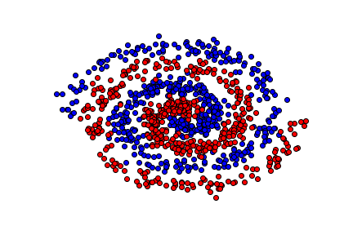
Spiral Data Set
You are given a data set with sample points as shown in the picture
There are two classes in this data set
Develop a model that predict the correct class given x and y
Think of what transformations you can use to make the data linearly separable

Slide 7
Mice Gene Data Set
Background:
Genes are the basic units in the DNA and encode blueprints for proteins
When proteins are synthesized from a gene, the gene is said to “express”
Scientists measured the expression levels of a large number of genes for a group of mice
Each mice can be characterized by:
Whether they had down's syndrome (trisomy) or not
Whether they were stimulated to learn or not
Whether they had a drug memantine or a saline control solution
With these three choices, there are 8 possible classes for each mouse
The data set:
Expression levels of 77 proteins
1080 measurements of protein expression level
Each measurement is labeled with the one of 8 possible classes
Goal: Predict the class of a mice given the protein expression level

Slide 8
Work on the Project
Things to keep in mind:
Check your dataset for any missing values
Think of using transformations to improve your accuracy
Split your data set into train/test sets
Test your model on your test set to check accuracy and whether there is overfitting
Change model order/use regularization to prevent overfitting
Ask for the validation set after you finalize your model

Slide 9
Presentation
30 minutes to prepare for presentation
Your presentation has to include:
Introduction of the problem that you worked on
What choices did you make in designing your model
Explain why you made those choices
Any problems in your model (for example, overfitting) and how you dealt with it
Test, train, and validation score and how you might improve it

Slide 10
Why the hype today?
Thank You!

